Slide 1
Developing Educational Videos

Slide 2
Let’s ask ourselves
Why do we watch a video?
When do we watch a video?
What makes us engaged in the video?

Slide 3
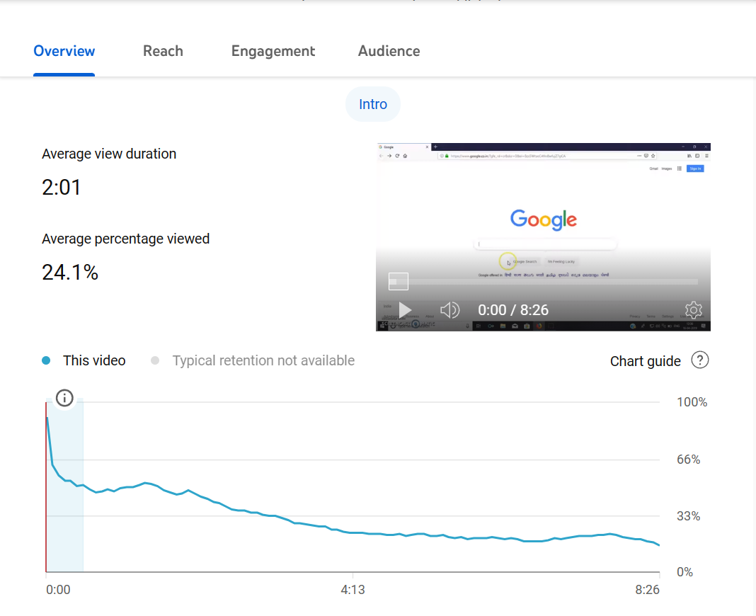
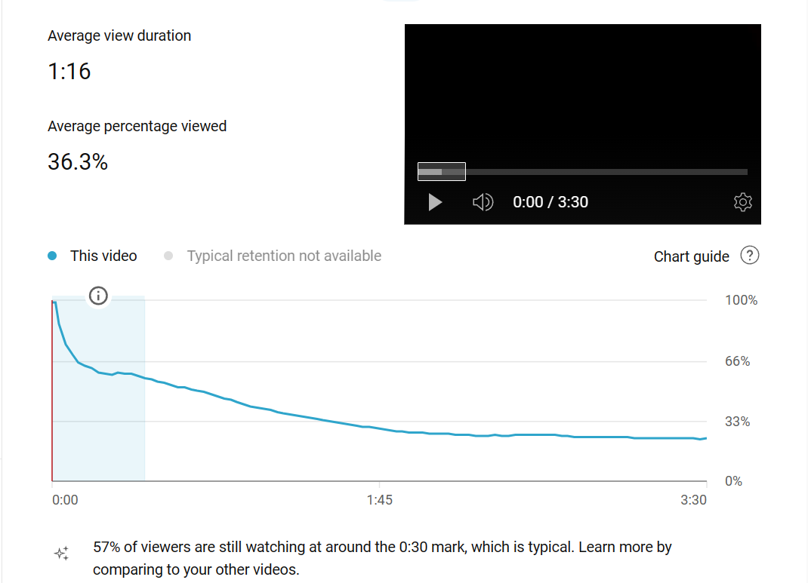

Slide 4
Types Of Educational Videos
Documentary
PPT-based lectures
Discussions
Classroom lectures
Demonstration Videos

Slide 5
The criteria of quality
Content
Format
Expert

Slide 6
Content
Appropriate to the format and level
Engaging
Contextualized

Slide 7
Length of Video
The attention span
Nature of Content
Engaging activities
Slot timing
Platform

Slide 8
The Subject Matter Expert
Conceptual clarity
Confidence
Pronunciation
Good Communicator
Pleasing Personality

Slide 9
Screen Presence
Good Screen Presence
Engaging elements
Multi-camera set-up
Different Frames (10 sec rule)

Slide 10
Resources
OER content
Authentic Resource books
Copyright-free images, videos, and sound
Video clips integration

Slide 11
Types Of Educational Videos
Documentary
PPT based lectures
Discussions
Classroom lectures
Demonstration Videos

Slide 12
Components of Video Recording
Video recording
Preparation of PPT

Slide 13
Slide Orientation
Keep it 16:9

Slide 14
Preparation of PPT
Slide should preferably have…
black character on white background, dark blue color as variation for black
uniform font type and size throughout the PPT
only one conceptual entity per slide
around 4-5 lines – to explain or present a concept
Keep Slide Orientation 16:9

Slide 15
Serif vs. sans serif font
Serif | Sans Serif
Aprajita Times new roman Cambria Courier | Century Arial calibri

Slide 16
Science in Modern India

Slide 17
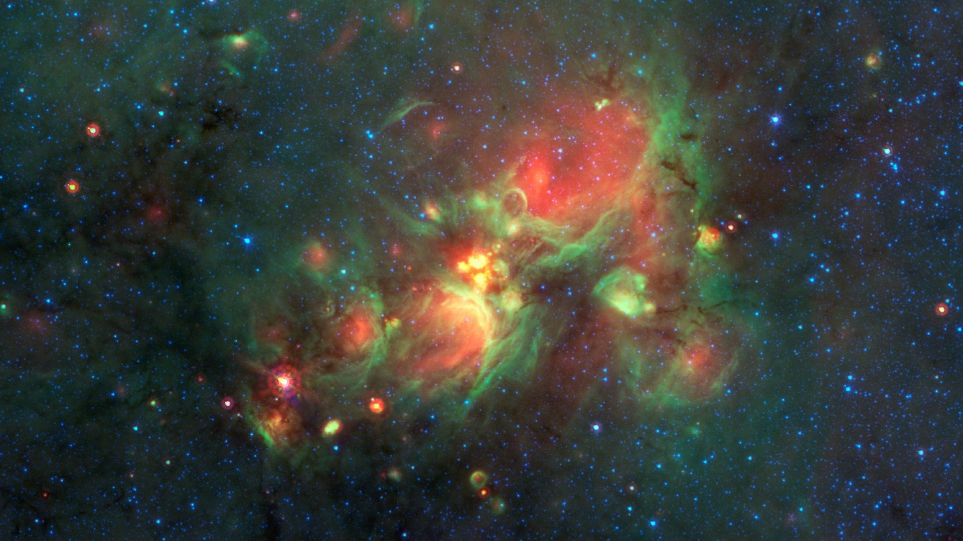
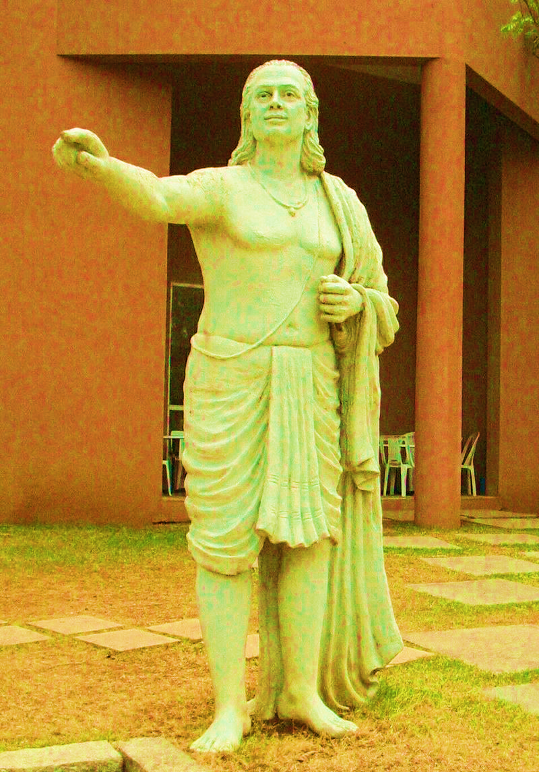
Aryabhata (Astronomer and Mathematician)
Wrote Aryabhatiyam in 499 CE.
Was the first to proclaim that
the earth is round,
it rotates on its axis, orbits the sun, and
is suspended in space.

Slide 18
आलोचनात्मक सचेत्नात्मकता
आलोचनात्मक सचेत्नात्मकता हमारे अपने वैयक्तिक अनुभवों तथा सामाजिक तंत्रों के बीच संबंधों की समझ तक पहुँचने की एक प्रक्रिया है।
- शोर (१९९२), पृष्ठ १२९.

Slide 19
B.Ed. Practical Activities (WORKSHOP-II)

Slide 20
Workshops in B.Ed. Programme
Course Code | Workshop | Credits | Days
BESL-131 | Workshop-I (First Year) | 04 | 12
BESL-132 | Workshop-II (Second Year) | 04 | 12

Slide 21
Objectives of the Course
examine the different perspectives in child development
analyze and reflect upon the impact of developmental contexts such as family life, schooling, peer groups and media on children’s development

Slide 22
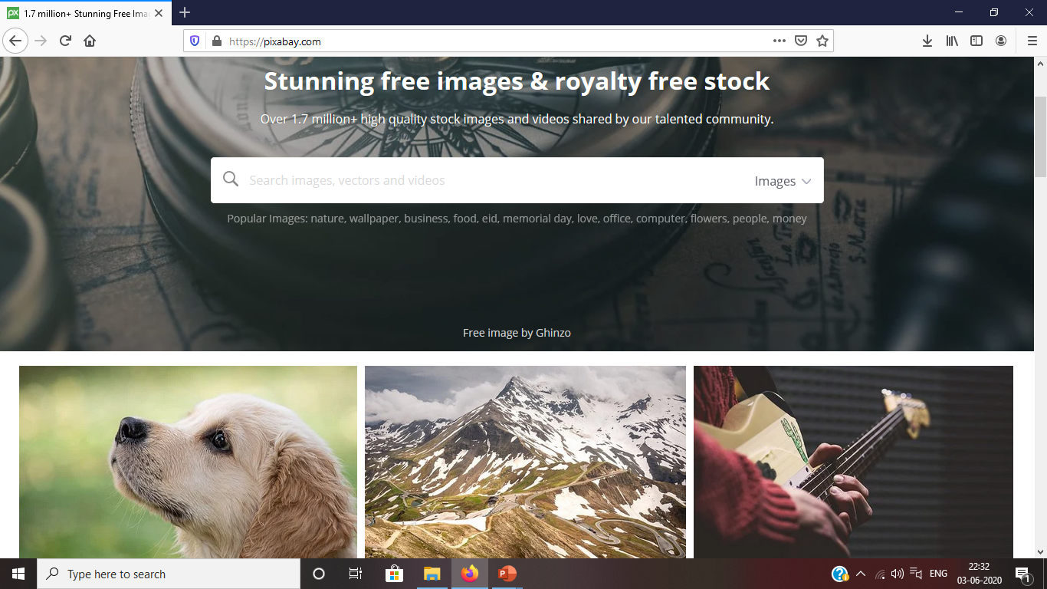

Slide 23
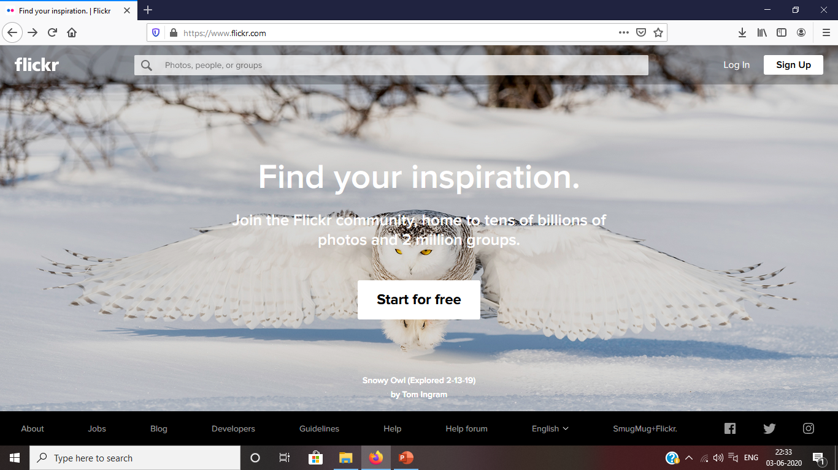

Slide 24
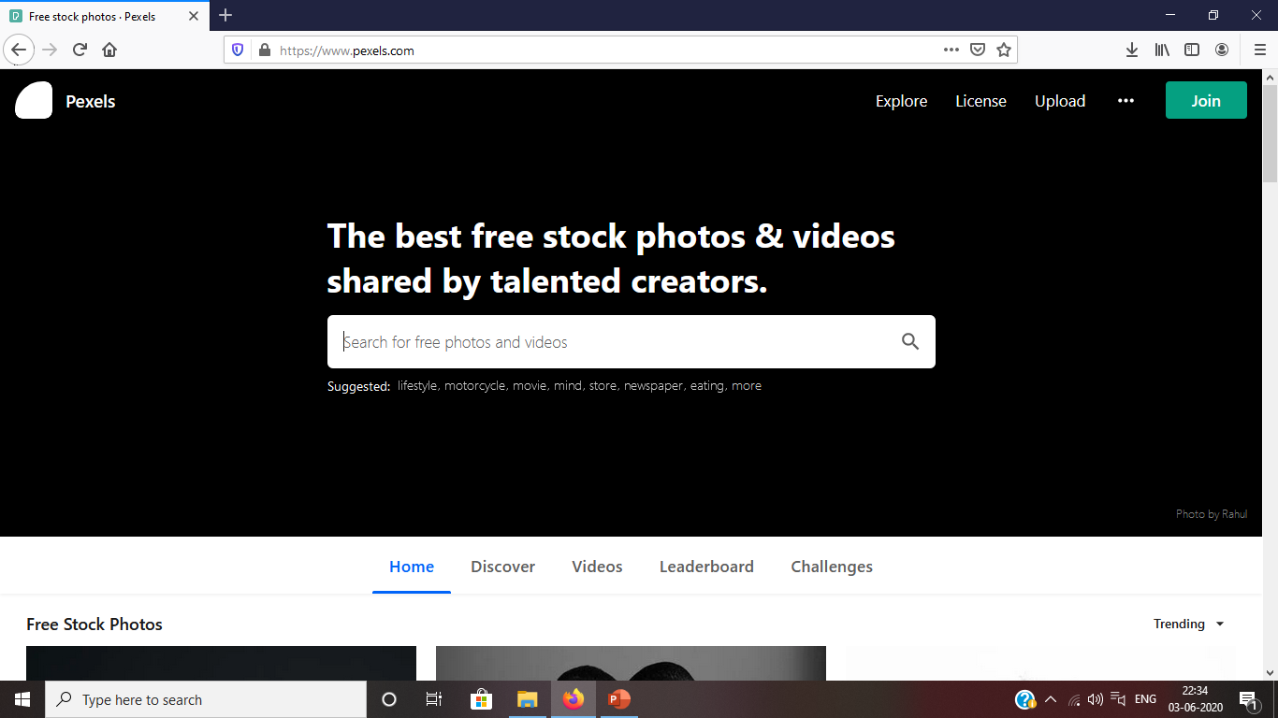

Slide 25
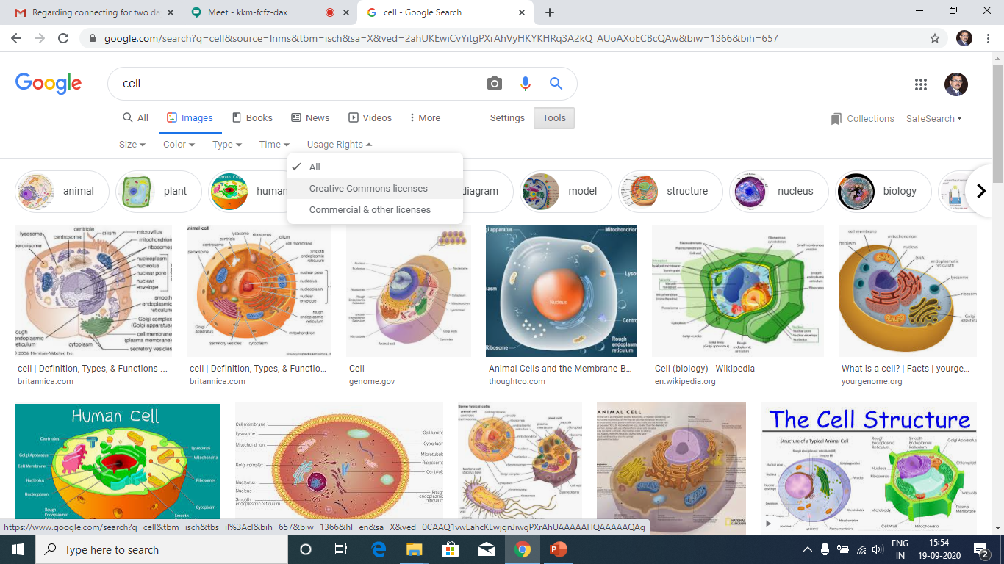

Slide 26
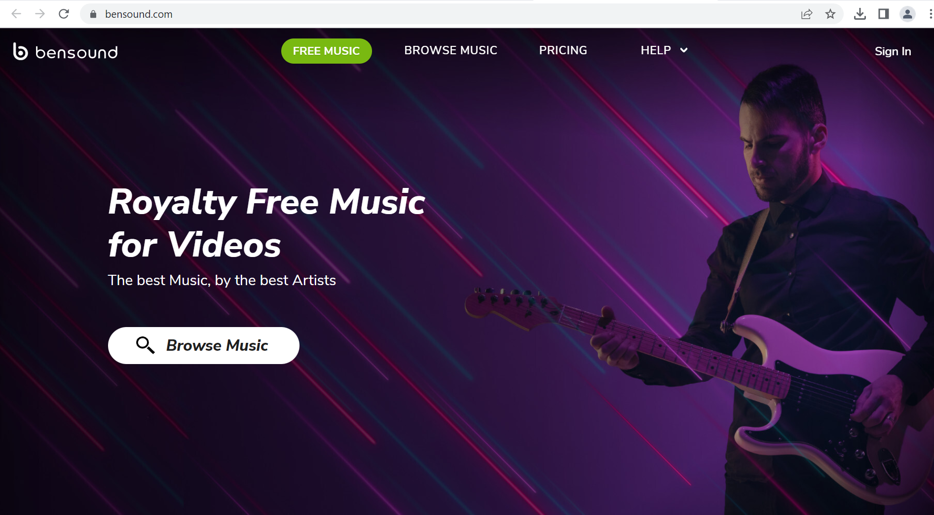

Slide 28
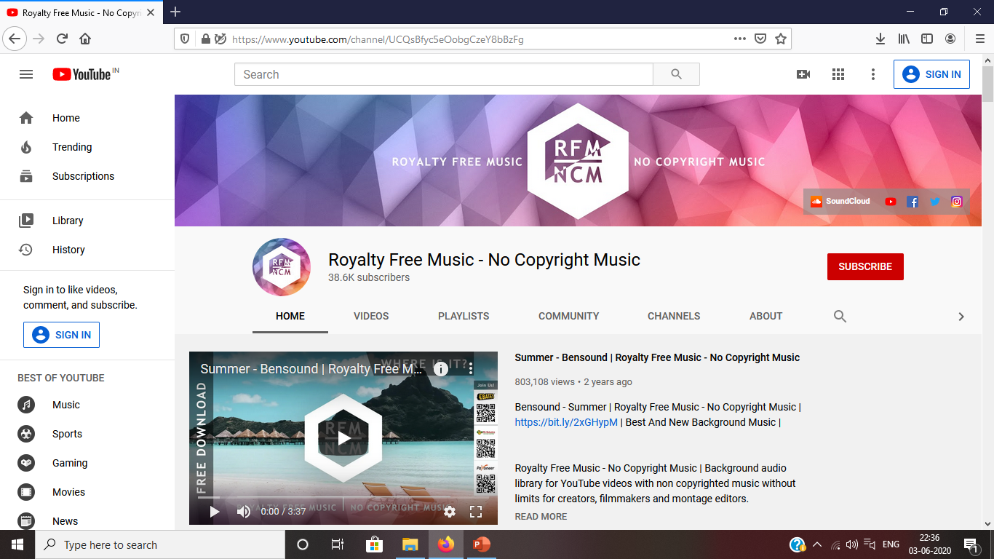

Slide 29
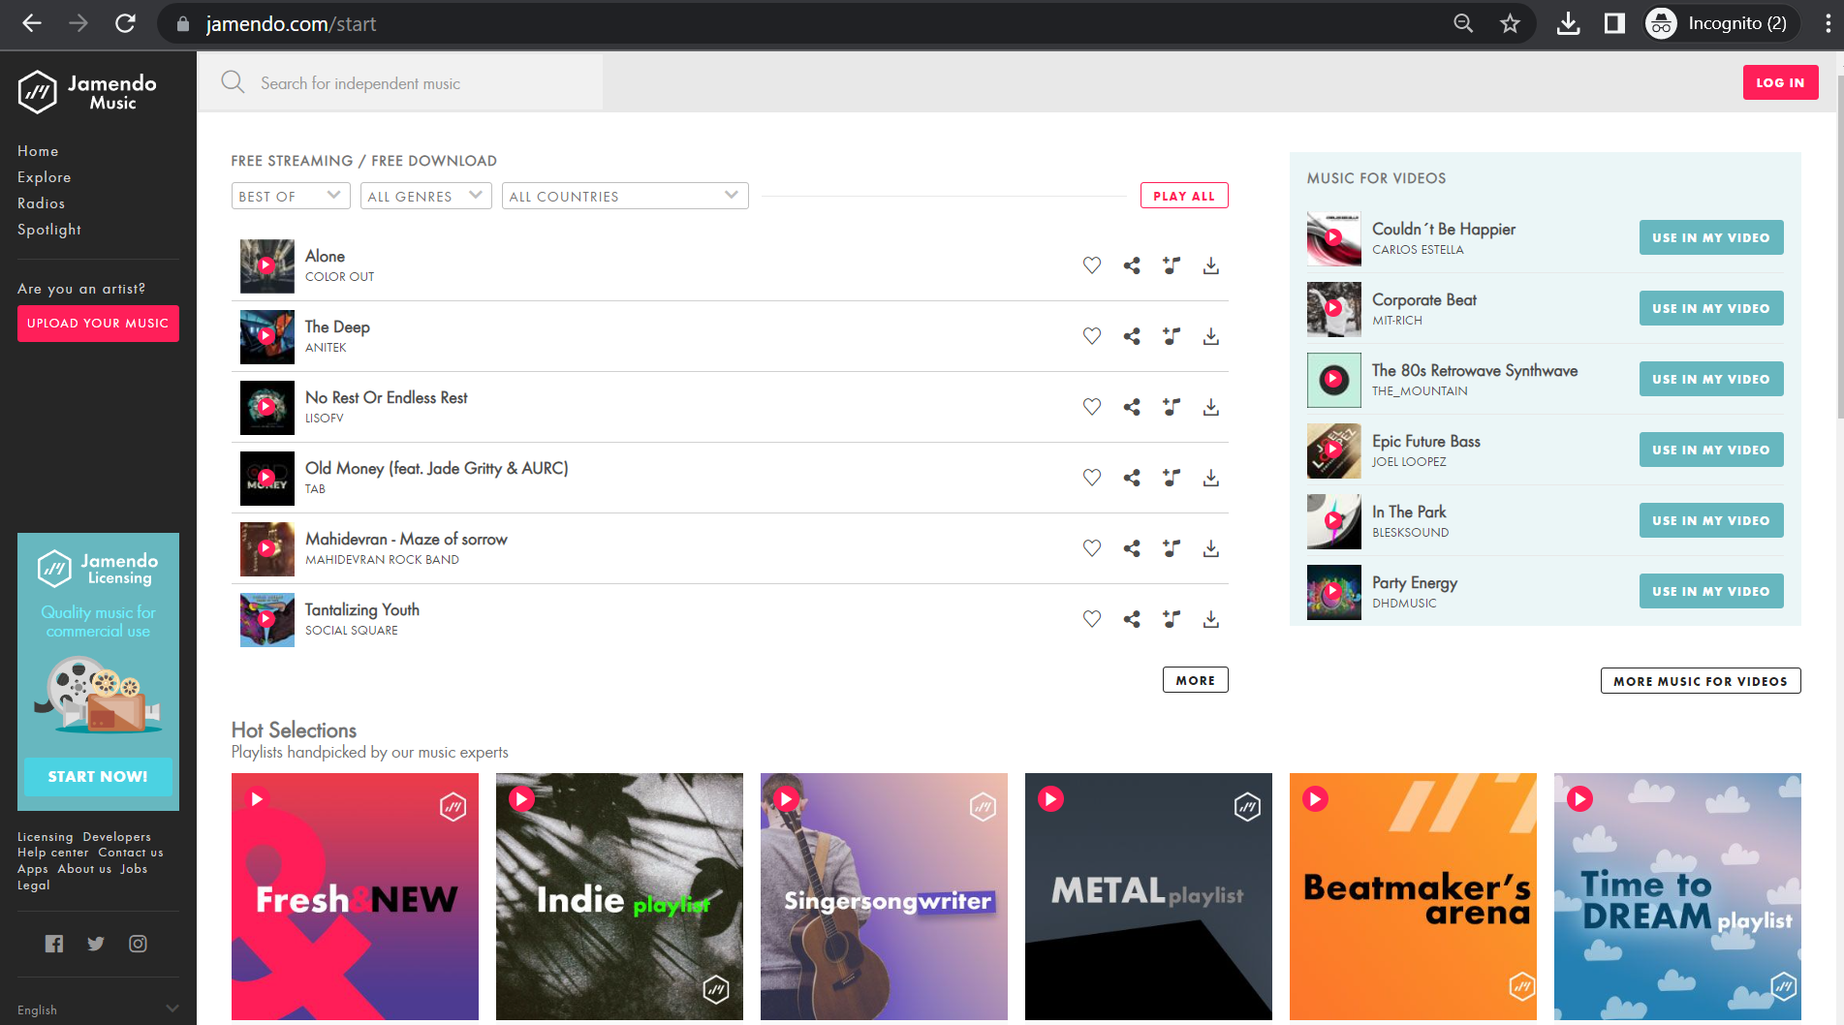

Slide 30
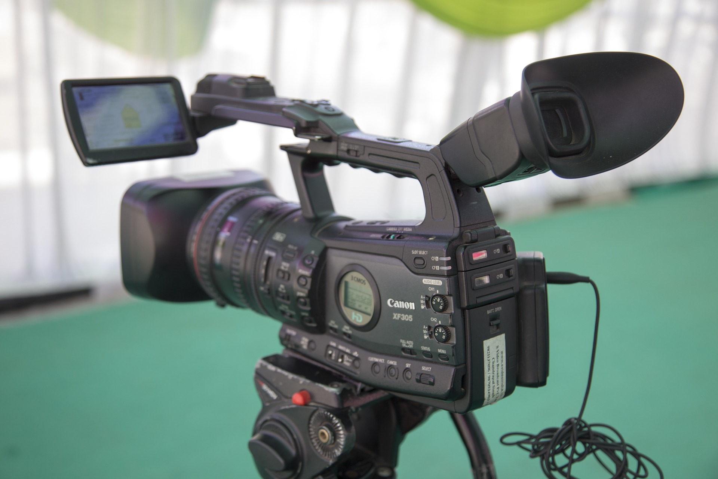
Video Recording
While recording, one should
look at the camera lens most of the time, especially in the opening and closing sentences
make less body movement
have even weight on both legs

Slide 31
For recording
prepare introductory and closing sentences beforehand
words and sentences can be repeated (managed by video editing)
watch out for disfluencies (sounds like umm, ahh etc.) and catchwords

Slide 32
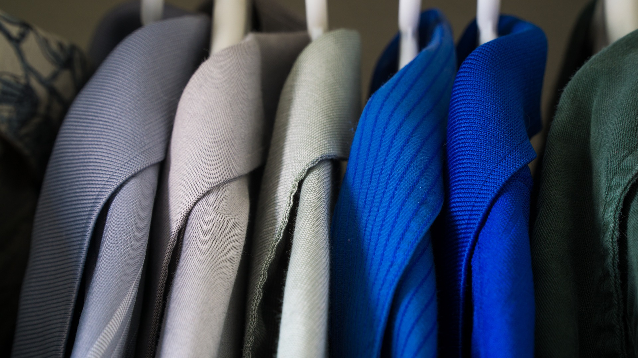
Dress Code …
suitable for the topic, culture, season and climate
generally formal, plain in one color
thin stripes should be avoided as it creates moving patterns
one extra set of dress should be kept for re-recording at short notice
do not wear dress or accessory with advertisement

Slide 33
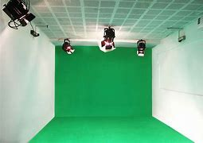
Keep Chroma Color in Mind (For studio recording)

Slide 34
Video duration
can range from 4 to 14 minutes
introductory video for a course –3-5 minutes
greetings should be independent of time of the day

Slide 35
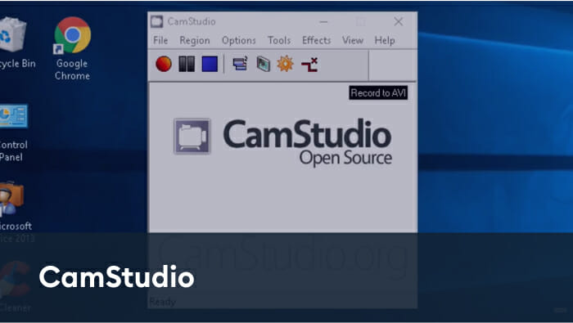
Screen Recording Options
A-Z Recorder

Slide 36
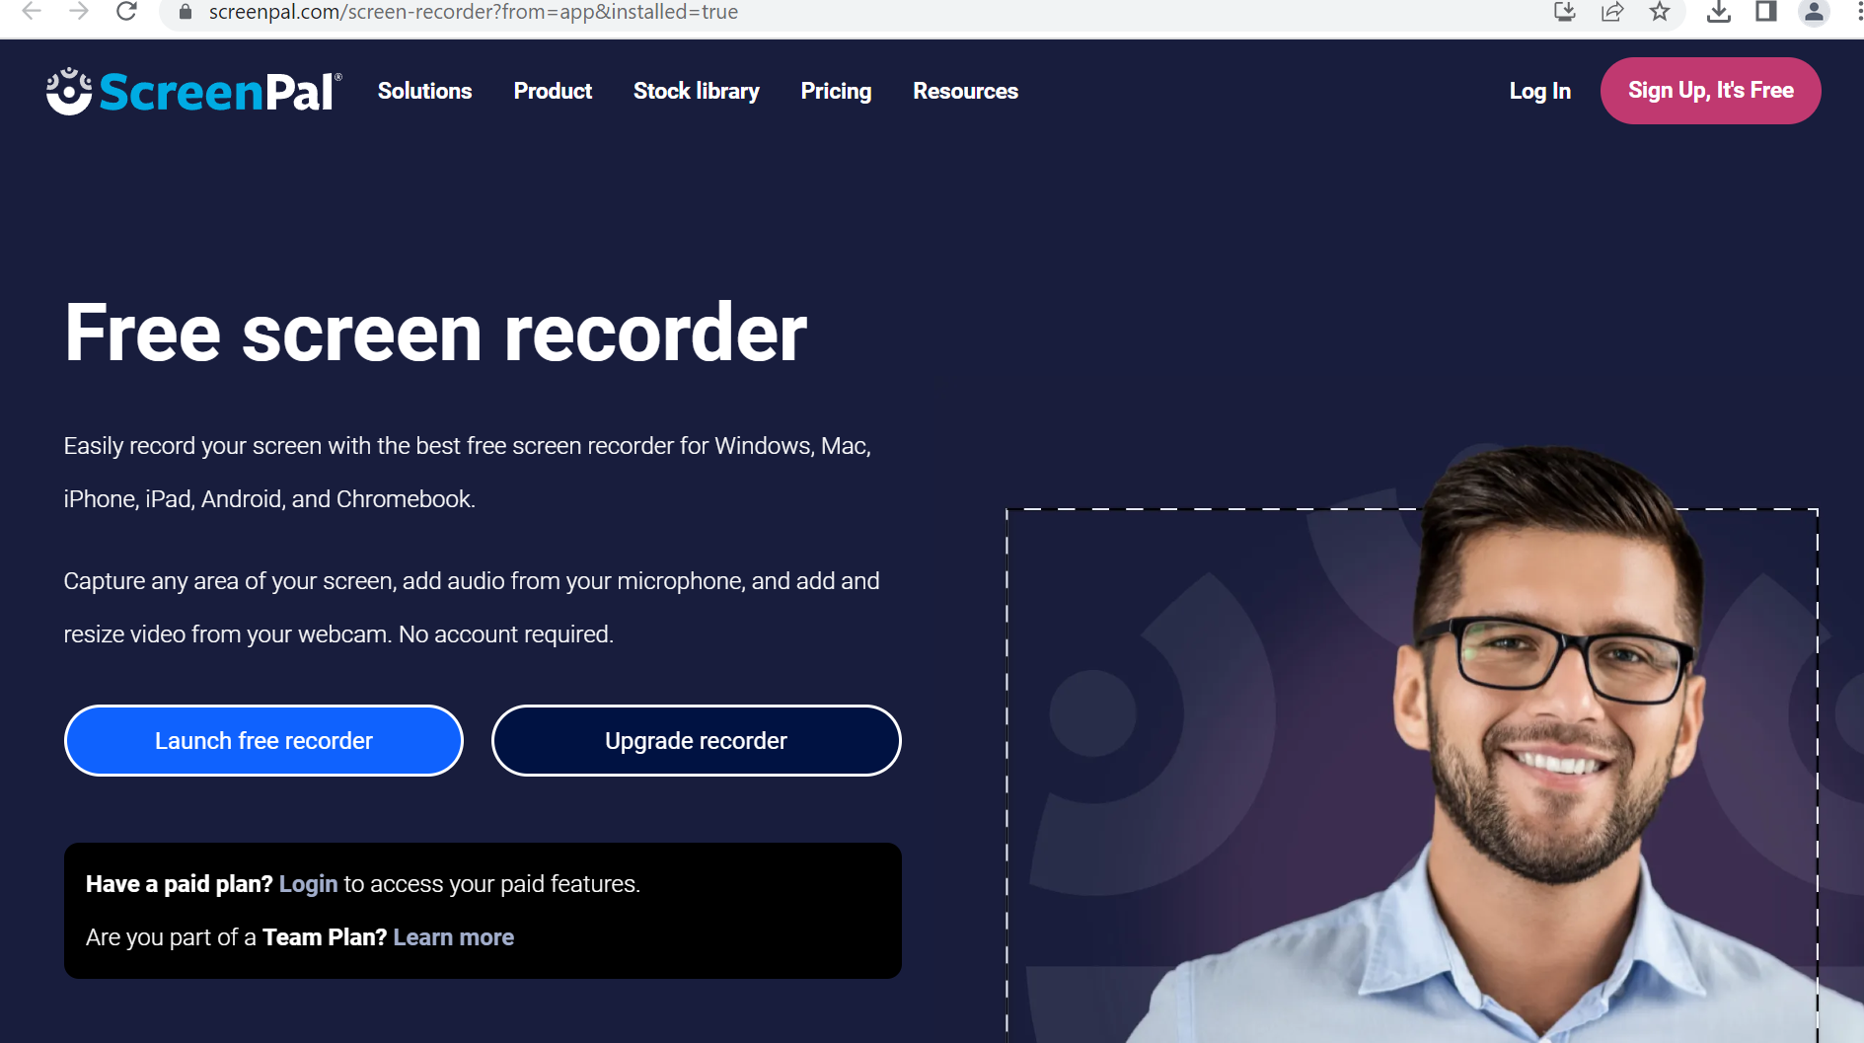

Slide 37
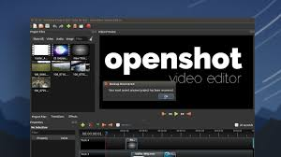
Popular Video Editing software

Slide 39
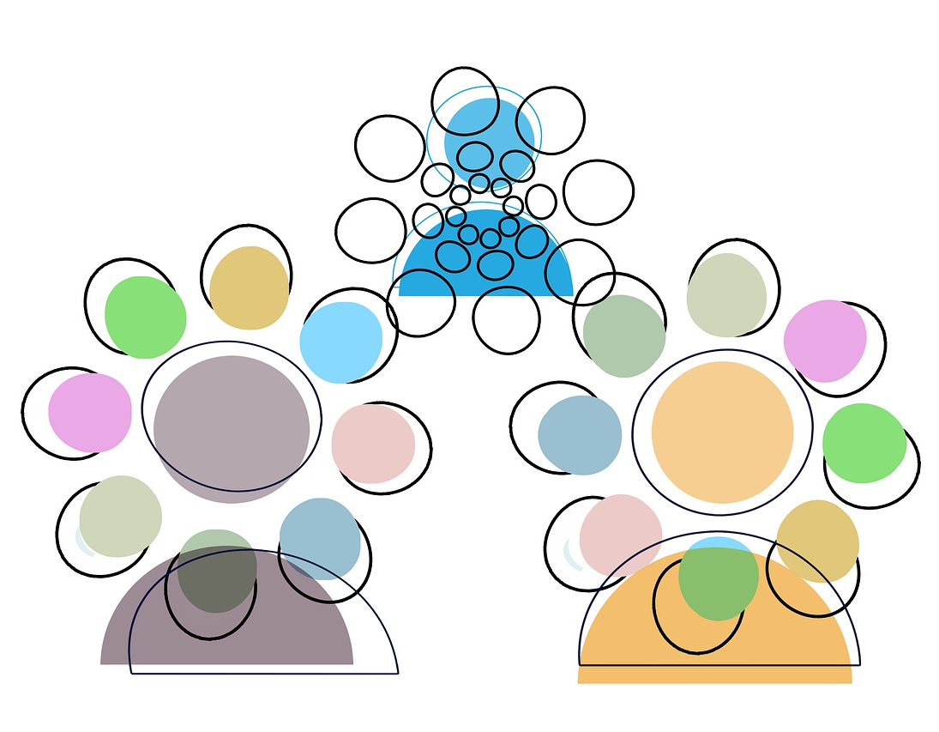
Making the video effective
Hooking up
Engaging
Prompting
Questioning/Challenging
Less textual
interactive

Slide 40
Appropriate to all formats

